Slide 1

CAPSTONE PROJECT Optical Recognition of Handwritten Digits using Sklearn
Presented By
Student Name: Rituraj Singh
College Name: Dayananda Sagar Academy of technology and Management
Department: CSE-AI
Email ID: ritturaj2004@gmail.com
AICTE Student ID: STU6763da265fb621734597158

Slide 2
OUTLINE
Problem Statement
Proposed System/Solution
System Development Approach (Technology Used)
Algorithm & Deployment
Result
Conclusion
Future Scope
References

Slide 3
Problem Statement
Despite the rise in digitization, recognizing handwritten digits remains a challenging task for machines due to varying writing styles, distortions, and noise. A robust and accurate method is required to automate digit recognition from handwritten input—particularly useful in areas like postal automation, bank check processing, and form digitization.

Slide 4
Proposed Solution
The system aims to accurately identify digits from handwritten images using machine learning (SVM).
Components include:
Data Collection: Use the Scikit-learn 'digits' dataset of handwritten digits.
Data Preprocessing: Normalize and reshape image data.
Model Development: Train a Support Vector Machine (SVM) for classification.
Deployment: Implement a user interface for real-time digit recognition.
Evaluation: Assess performance using accuracy, precision, recall, and confusion matrix.

Slide 5
System Approach
System Requirements:
Python 3.8+, 6-core CPU, GPU
Used:
TensorFlow / Keras
NumPy
scikit-learn
Matplotlib
Streamlit (optional for deployment)

Slide 6
Algorithm & Deployment
Algorithm:
Support Vector Machine (SVM)
Data Input:
8x8 grayscale images (Scikit-learn digits dataset)
Training Process:
Train on 60,000 labeled digit images5-layer
CNN (Conv + Pooling + Dense + Softmax)Prediction
Process:
Classifies input image to one of 10 digits (0–9)
Deployment:
Pickle model saved for future inference

Slide 7
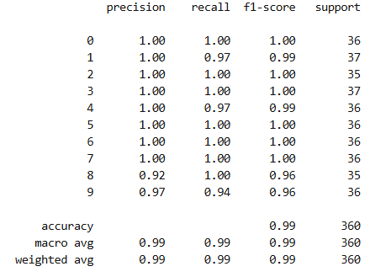
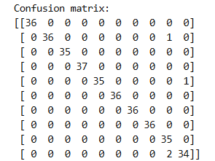

Result
Accuracy Achieved: ~98.9% on Scikit-learn 'digits' test dataset
Model successfully recognizes digits from unseen handwritten images with high precision.

Slide 8
Conclusion
The developed SVM model shows high accuracy in recognizing handwritten digits, confirming the effectiveness of machine learning (SVM) in OCR tasks.
It demonstrates real-world usability in document scanning, bank automation, and form processing systems.

Slide 9
Future scope
Extend recognition to letters and symbols
Use real-world noisy datasets (not just Scikit-learn 'digits')
Convert into a mobile app or embedded solution
Explore Transformer-based models for improved accuracy
Real-time camera input for live recognition

Slide 10
References
Scikit-learn 'digits' Dataset: http://yann.lecun.com/exdb/mnist/
[Paper] LeCun, Yann, et al. "Gradient-based learning applied to document recognition." (1998)
Scikit-learn Documentation.
GitHub Link: https://github.com/RiturajSingh2004/OCR-using-SVM

Slide 11
Thank you

